Slide 1

MLB MVP Voting

Slide 2
Background
Two leagues in MLB, writers vote for 1 MVP in each league each year
There are 30 voters in each league, each ranks their top 10 candidates in each league
Player with most total points is MVP winner

Slide 3
The Task
Find which statistics have the biggest impact on MLB MVP voting
See how dependency on certain stats has changed over time as analytics has gotten more mainstream in baseball
Are voters relying more heavily on the more modern stats as they are more readily available

Slide 4
The Data
MVP voting results and player stats scraped from baseball-reference.com
Team records downloaded from kaggle
The MVP voting pages had each players team so joined to the records on that value
Looked at voting results from 1950-2019

Slide 5
Points Of Focus
Older traditional stats vs. modern analytical stats
Only looked at batter performance, pitchers removed from dataset
Looked at performance trends over years and decades
Primary traditional stats are the “triple crown” stats: home runs, RBI and average
Modern analytical stat used is WAR (Wins Above Replacement)

Slide 6
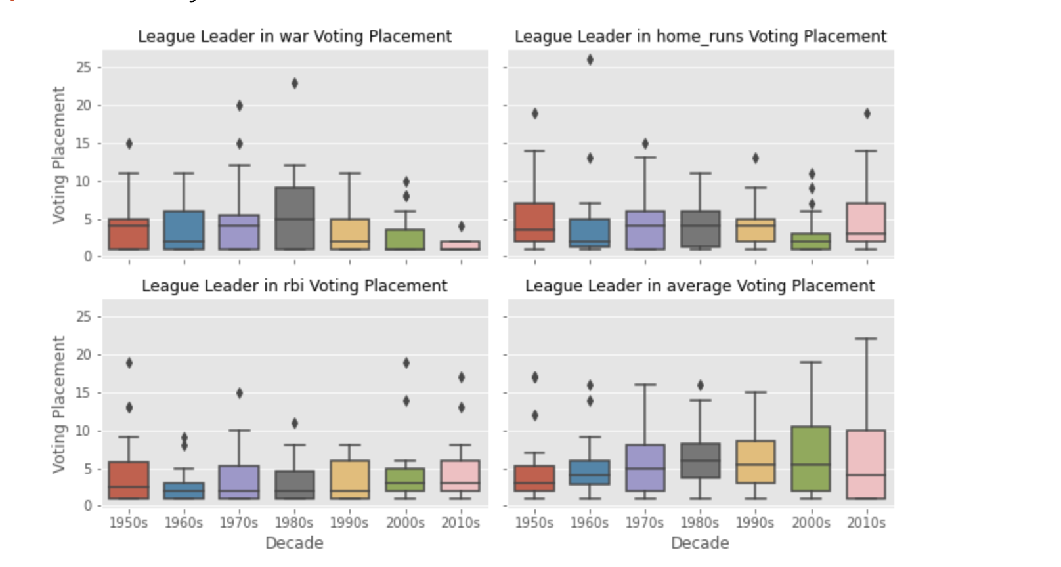
League Leader Performance In Voting
The voting place of league leader in war/home runs/rbi/average broken out by decade
The league leader in war is much more likely to finish towards the top of MVP voting in recent decades. League leader in RBI much more likely to finish high in voting pre 2000s

Slide 7
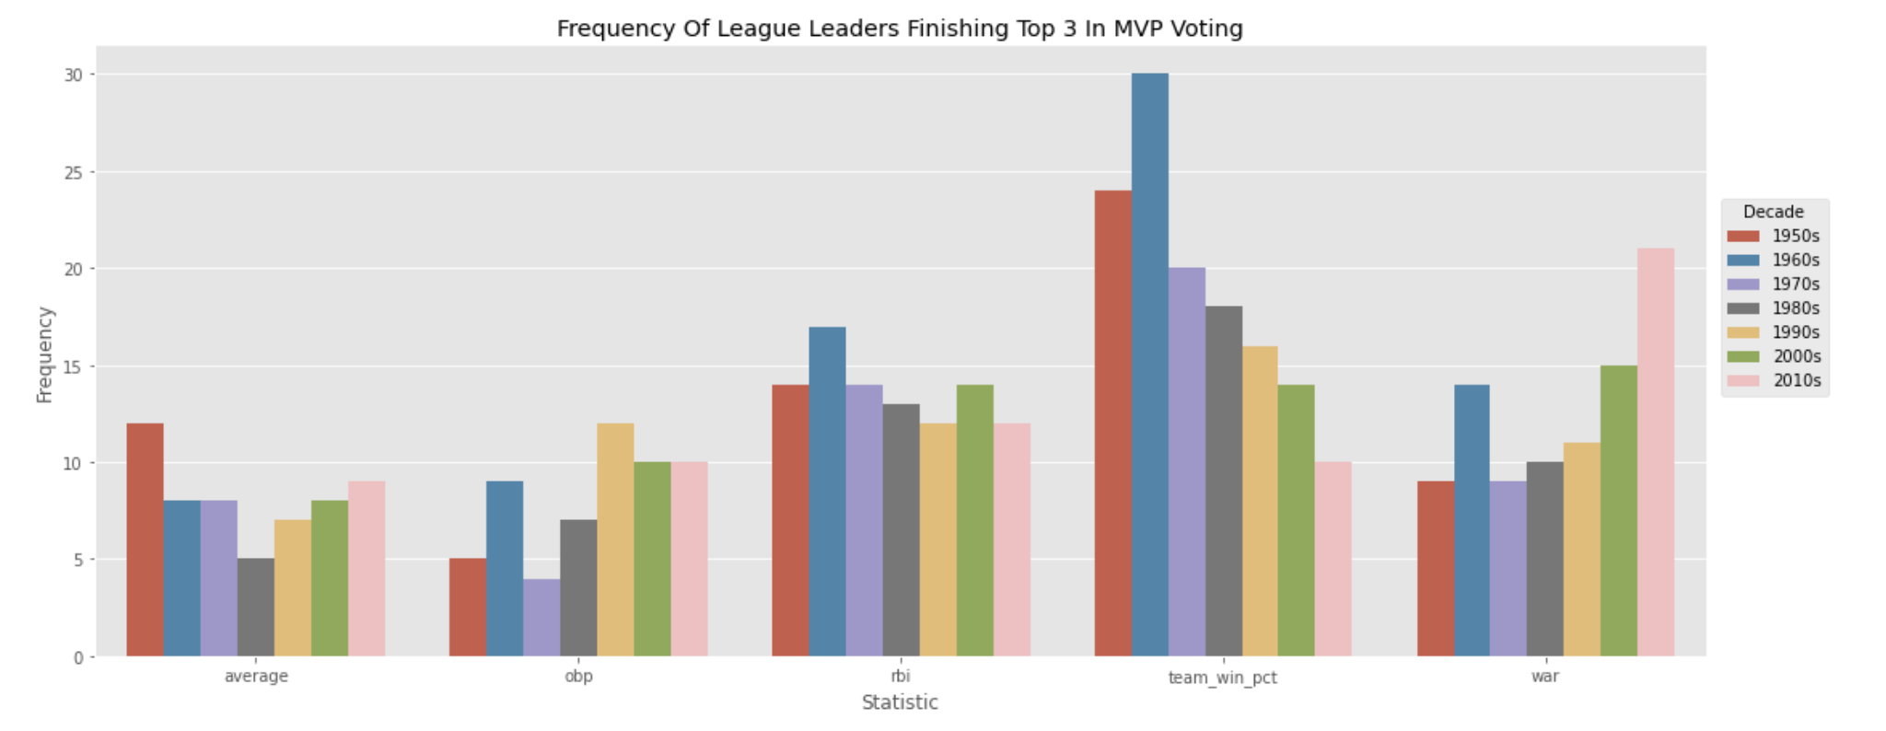
League Leader Performance In Voting
The number of times a league leader in war/home runs/rbi/average/team win pct finished top 3 in MVP voting broken out by decade
Similar trends as prior slide, also notable team record does not appear to play as big of a role

Slide 8
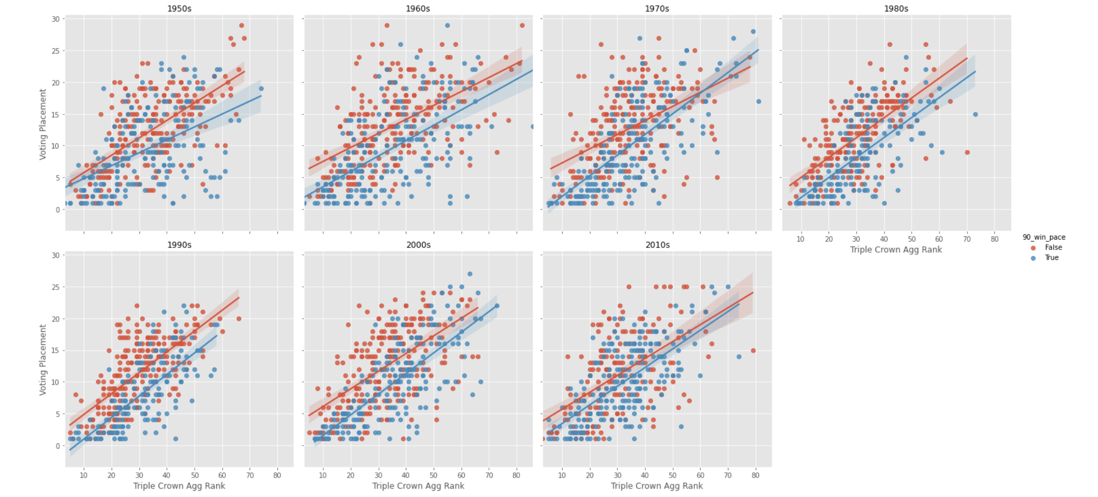
Triple Crown Ranks Relative To Voting Place By Team Quality
The better a player does in the triple crown categories the better they do in MVP voting
The better a team is also helps, though the importance has shrunk over time

Slide 9
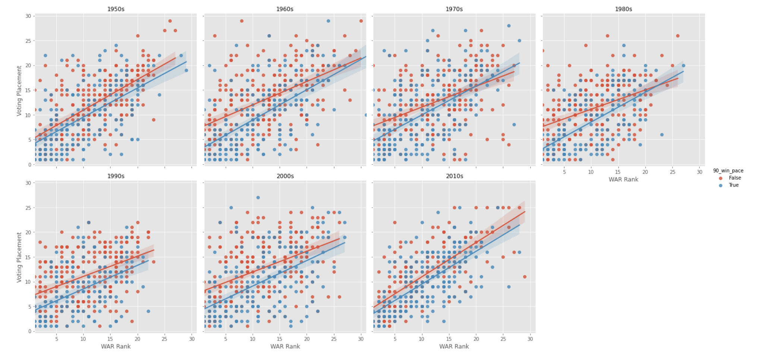
WAR Rank Relative To Voting Place By Team Quality
The better a player does in WAR the better they do in MVP voting
The better a team is also helps, though the importance has shrunk over time

Slide 10
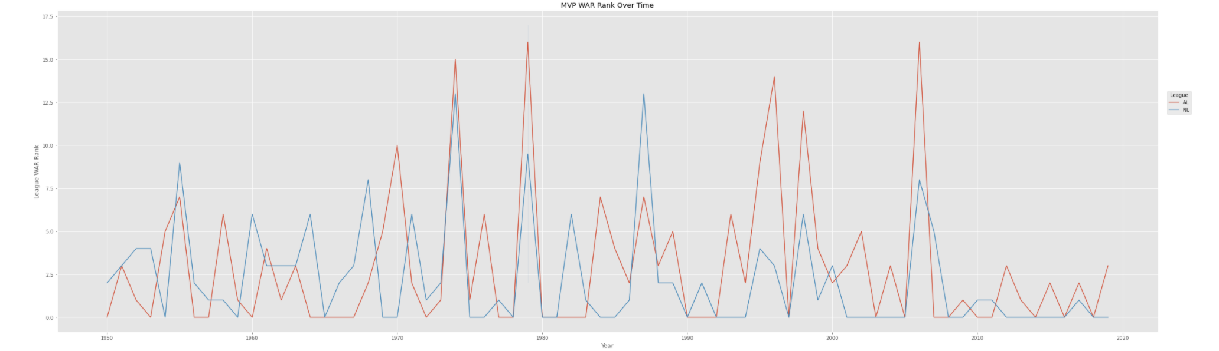
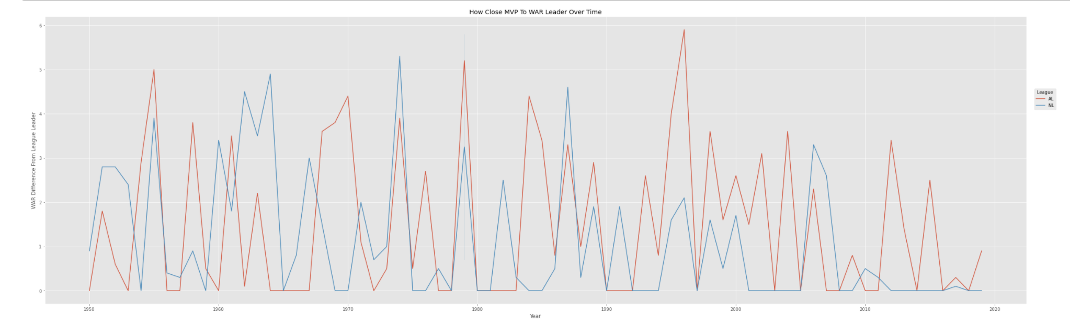
MVP Winner War Performance Relative To League Leader
MVP Winner WAR Rank (top) and difference in MVP winner WAR and WAR leader WAR (bottom)
Every few years appears to be a big discrepency though league leader (or close) tends to win MVP much more frequently

Slide 11
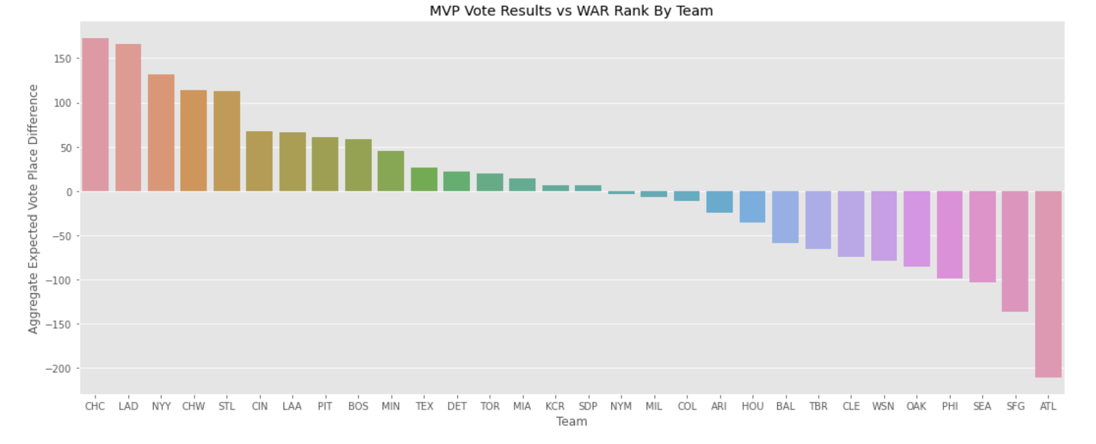
Expected Vote Performance By Team
Expected vote performance difference (League WAR Rank - MVP Voting Place) aggregated across all players for all years
Higher number means voting performance better than expected
Teams at top play in larger markets (Chicago/Los Angeles/New York) all top 4, market size can help over perform
San Francisco/Philadelphia in bottom 4 so market isn’t a be all end all

Slide 12
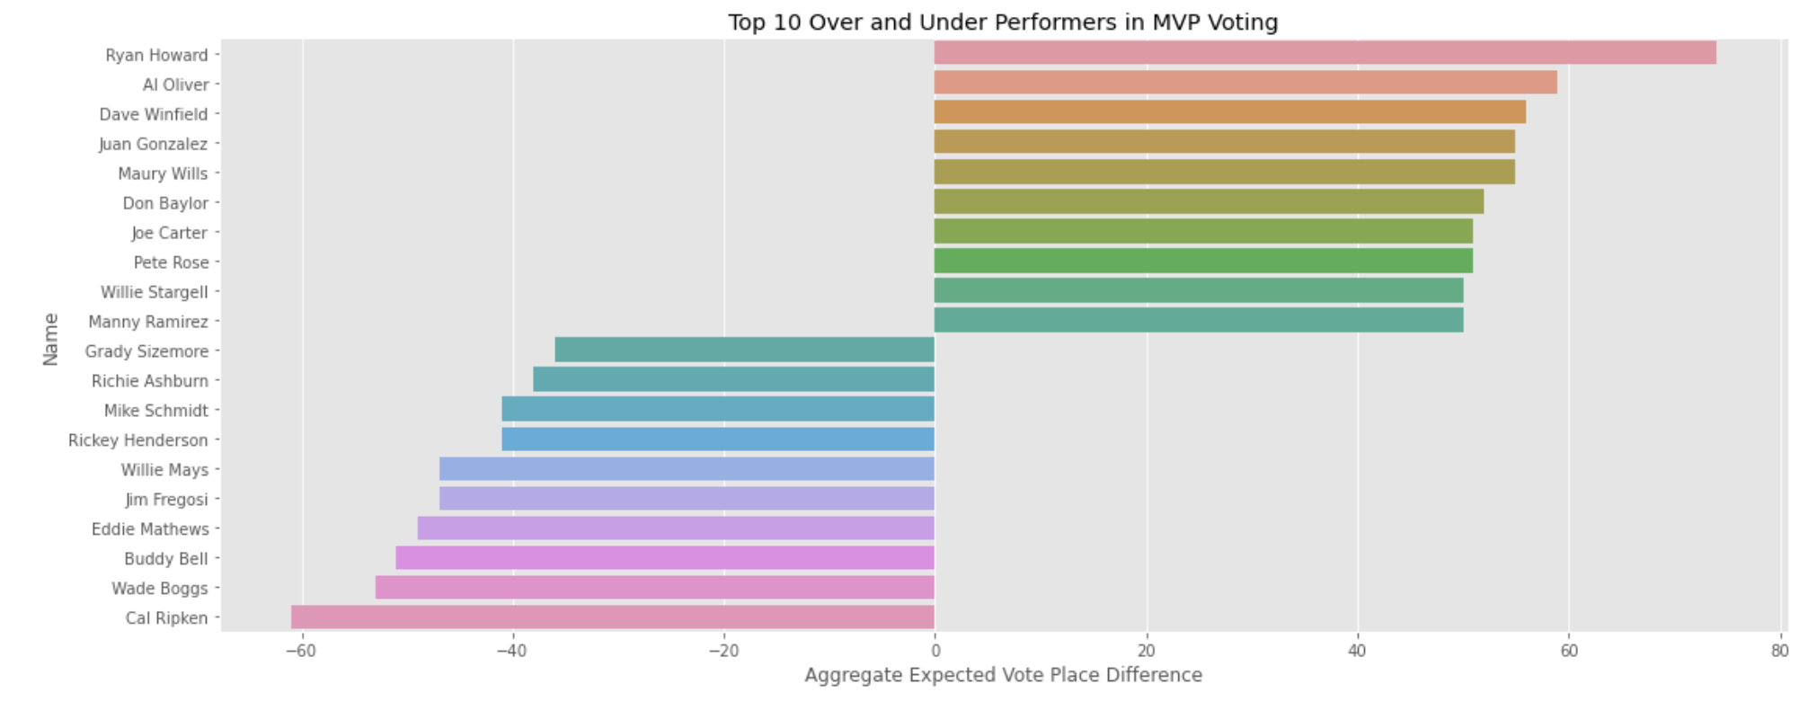
Expected Vote Performance By Player
Top and bottom 10 players in expected vote performance difference (League WAR Rank - MVP Voting Place)
Higher number means voting performance better than expected
Top 10 players are stronger offensive players who accumulate high RBI totals. Are extreme RBI totals very appealing?
Bottom 10 players are players generally well rounded skills and/or among the top of league in WAR every year. Voting fatigue?

Slide 13
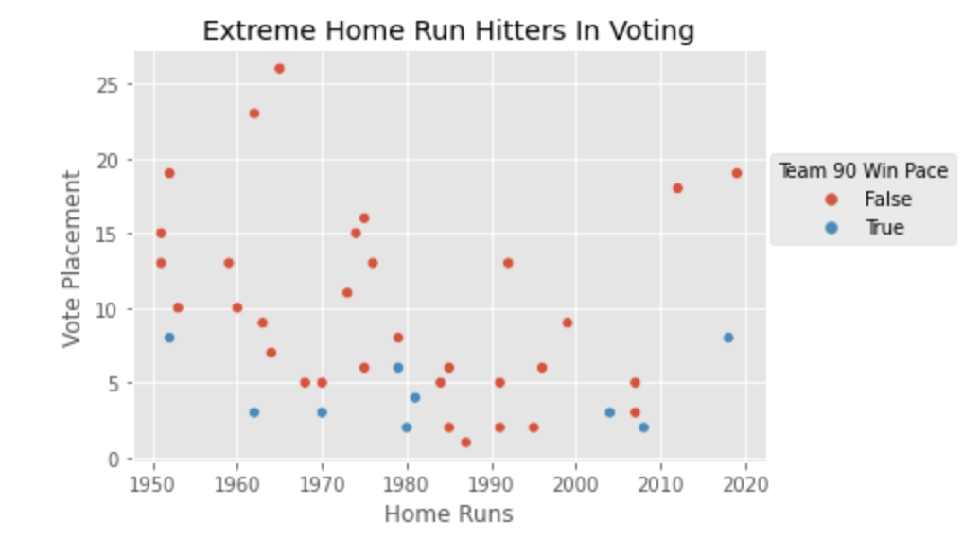
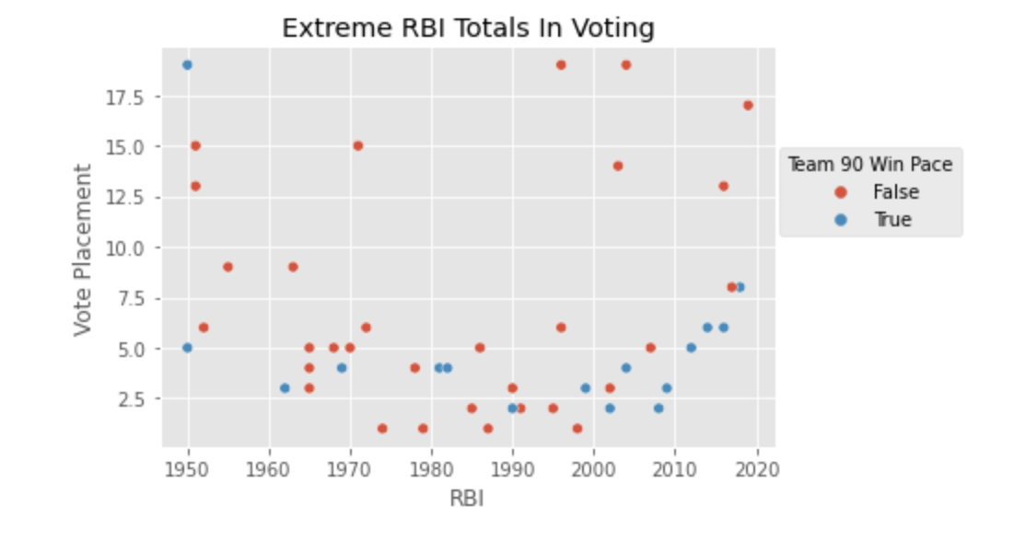
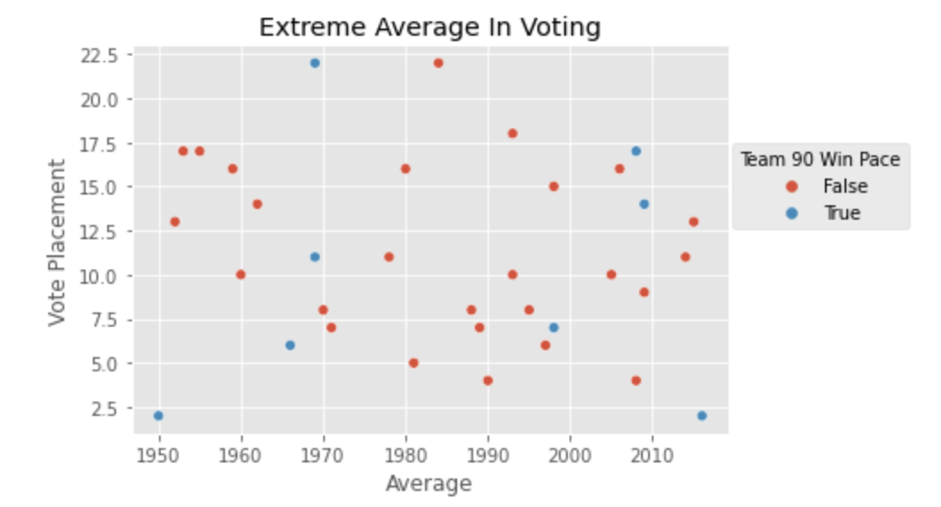
Extreme Performance Analysis (Triple Crown Stats)
Inclusive of seasons >= 1.5 standard deviations from league mean for that year and WAR not in top 10 of league
When the team had a 90 -win pace, high end extreme HR and RBI totals were valued very highly in MVP voting, almost guaranteed top 10 finish despite lower WAR rank
Extreme totals for teams below a 90-win pace still performed better than expected in voting though top 10 finish not as automatic
For extreme average performers quality of team was not as important and while some over performance not as extreme

Slide 14
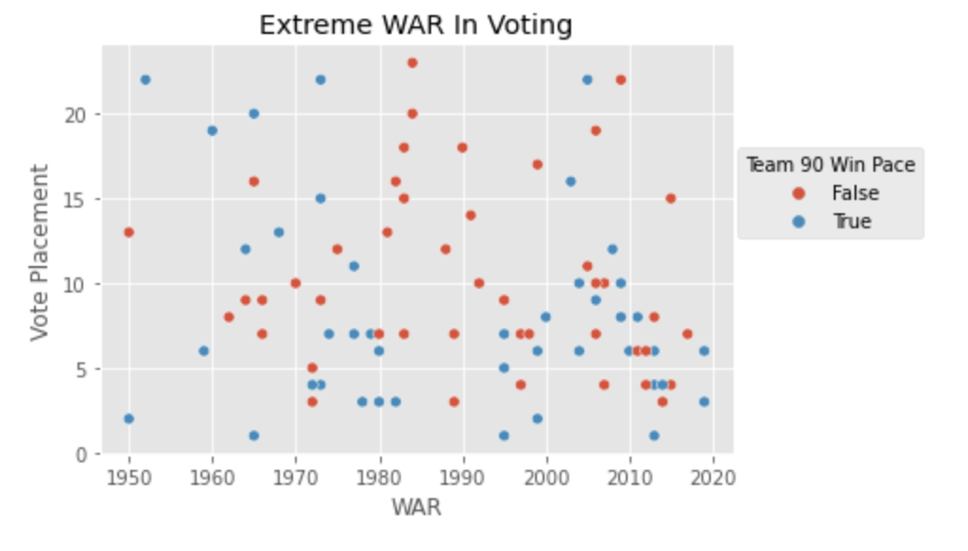
Extreme Performance Analysis (WAR)
Inclusive of seasons >= 1 standard deviation from league mean for that year and not top 5 in any triple crown categories
Extreme WAR totals have not directly led to very high MVP finishes though in the past decade is an almost automatic top 10 finish.
Team quality was also very important here, players on lower quality teams almost always finished outside top 10 pre-2010

Slide 15
Conclusions
As the amount of analytics in baseball used both by teams and fans has increased, the results of MVP voting have become more dependent on advanced stats as opposed to traditional stats.
Extreme performances in home runs in RBI still get valued very heavily in MVP voting
Team quality still matters and players on very good teams do better in MVP voting, and while it hasn’t mattered as much in recent years there is still a difference

Slide 16
Additional Areas Of Interest
How voter fatigue factors in, do voters get tired of voting for certain players if they are repeatedly among top players in league
What factor does market size play in MVP voting
Look into how pitchers factor in as well
Look into year/stadium adjusted metrics to standardize player performance

